Slide 1
ER Diagrams & Problem Formulation
Dr. Seema Gupta Bhol

Slide 2
Manufacturing Example
A manufacturing company produces products. The following product information is stored: product name, product ID and quantity on hand. These products are made up of many components. Each component can be supplied by one or more suppliers. The following component information is kept: component ID, name, description, suppliers who supply them, and products in which they are used.

Slide 3
Schemas
Product(ProdID, ProdName, QtyOnHand) PK=ProdID
Component(CompID, CompName, Description) PK=CompID
Supplier(SuppID, SuppName) PK = SuppID
CompSupp(CompID, SuppID) PK = CompID, SuppID
Build(CompID, ProdID, QtyOfComp) PK= CompID, ProdID

Slide 4
compsupp
component
suppliier
Build
Products

Slide 5
Company and employees
(a) Each company operates four departments, and each department belongs to one company.
(b) Each department in employs one or more employees, and each employee works for one department.
(c) Each of the employees may or may not have one or more dependants, and each dependant belongs to one employee.
(d) Each employee may or may not have an employment history.
(e) Represent all the ER diagrams described in (a), (b), (c), and (d) as a single ER diagram.

Slide 6
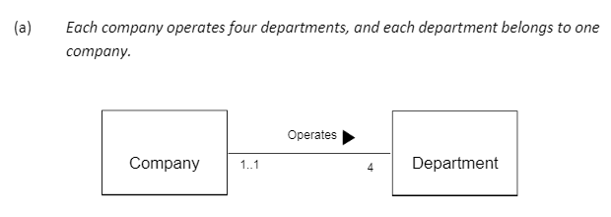
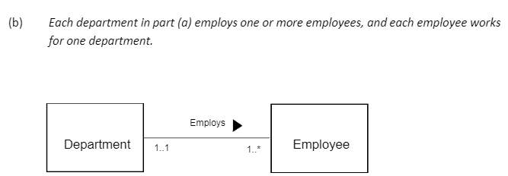

Slide 7
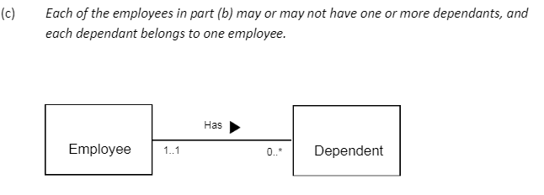
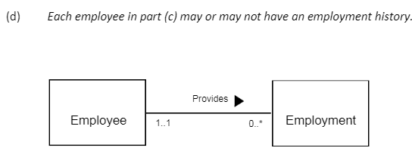

Slide 8
operates
Company
Department
Employs
Provides
Emp_history
Employee
has
Dependent

Slide 9
The Flight Database
The flight database stores details about an airline’s fleet, flights, and seat bookings.
The airline has one or more airplanes.
An airplane has a model number, a unique registration number, and the capacity to take one or more passengers.
An airplane flight has a unique flight number, a departure airport, a destination airport, a departure date and time, and an arrival date and time.
Each flight is carried out by a single airplane.
A passenger has given names, a surname, and a unique email address.
A passenger can book a seat on a flight.

Slide 10
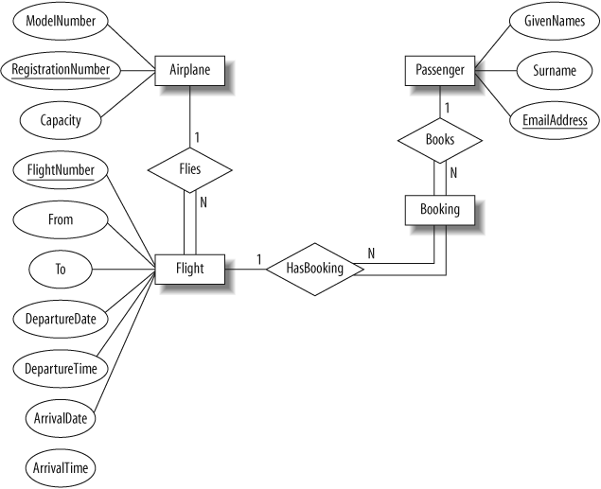

Slide 11
Transportation example
UPS is Transportation company .
Shipped items can be characterized by item number (unique), weight, dimensions, insurance amount, destination, and final delivery date.
Shipped items are received into the UPS system at a single retail center.
Retail centers are characterized by their type, uniqueID, and address.
Shipped items make their way to their destination via one or more standard UPS transportation events (i.e., flights, truck deliveries).
These transportation events are characterized by a unique scheduleNumber, a type (e.g, flight, truck), and a deliveryRoute.

Slide 12
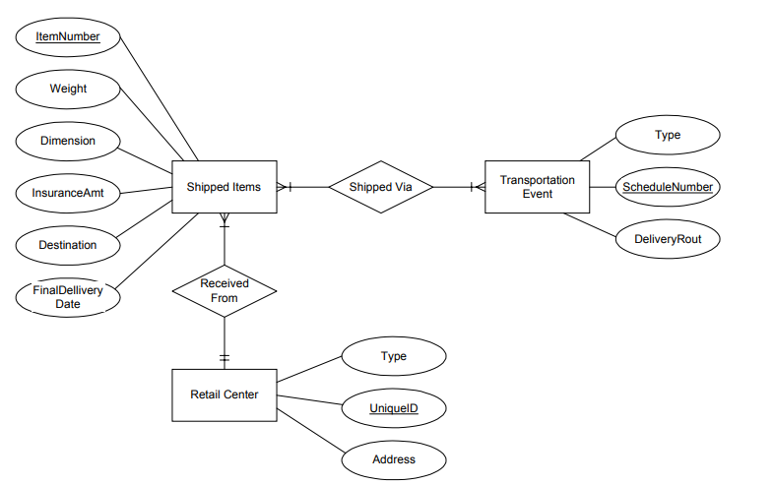

Slide 13
University example
A teacher can teach many courses.
A student can enroll in many courses.
A course may be a part of one or many programmes.
A teacher can be mentor of many students, however a student can have only one mentor.

Slide 14
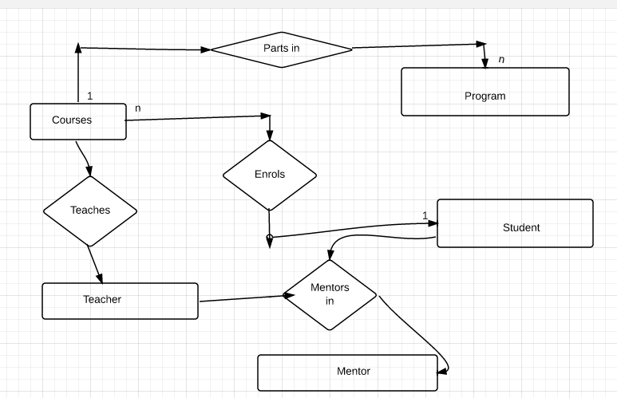
IGNORE DIRECTIONS OF ARROWS

Slide 15
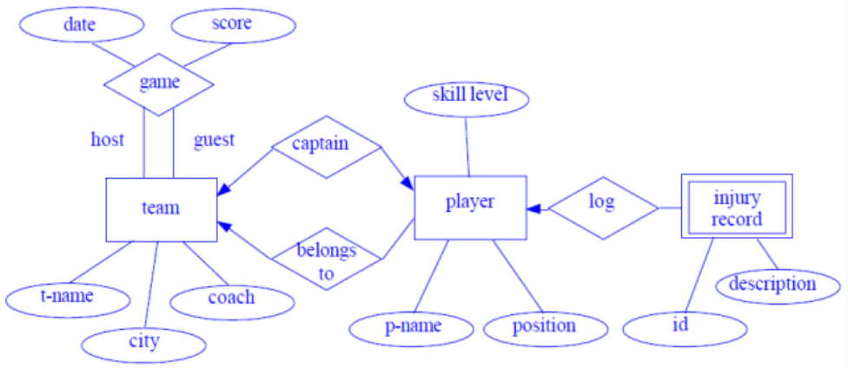

Slide 16
National Hockey League (NHL
The NHL has many teams, each team has a name, a city, a coach, a captain, and a set of players.
Each player belongs to only one team, each player has a name, a position (such as left wing or goalie), a skill level, and a set of injury records.
A team captain is also a player,
A game is played between two teams (referred to as host_team and guest_team) and has a date (such as May 11th, 1999) and a score (such as 4 to 2).

Slide 17
Company database
Company organized into DEPARTMENT. Each department has unique name and a particular employee who manages the department. Start date for the manager is recorded.
Department may have several locations. A department controls a number of PROJECT.
Projects have a unique name, number and a single location.
Company’s EMPLOYEE name, ssno, address, salary, sex and birth date are recorded.
An employee is assigned to one department, but may work for several projects (not necessarily controlled by her dept).
Number of hours/week an employee works on each project is recorded.
There is immediate supervisor for the employee.
Employee’s DEPENDENT are tracked for health insurance purposes (dependent name, birthdate, relationship to employee).

Slide 18
